Slide 1













CHAPTER 4
C’MON, GUYS!

Slide 2

In what situations do people make request and ask for permission?

Slide 3
MAKING REQUEST AND ASKING FOR PERMISSION

Slide 4

What specific language do you use when you make request or ask for permission?

Slide 5
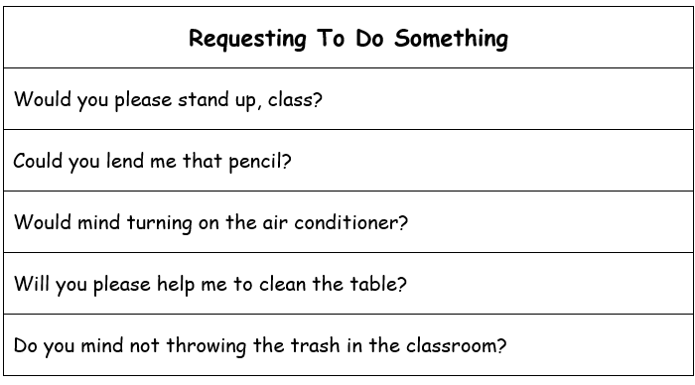

Slide 6
GIVING PERMISSION
REFUSING TO GIVE PERMISSION
Yes, please do.
Sure, go ahead.
Sure
No problem
Please feel free
No, please don’t
I’m sorry, but that’s not possible
I’m afraid, but you can’t

